Slide 1
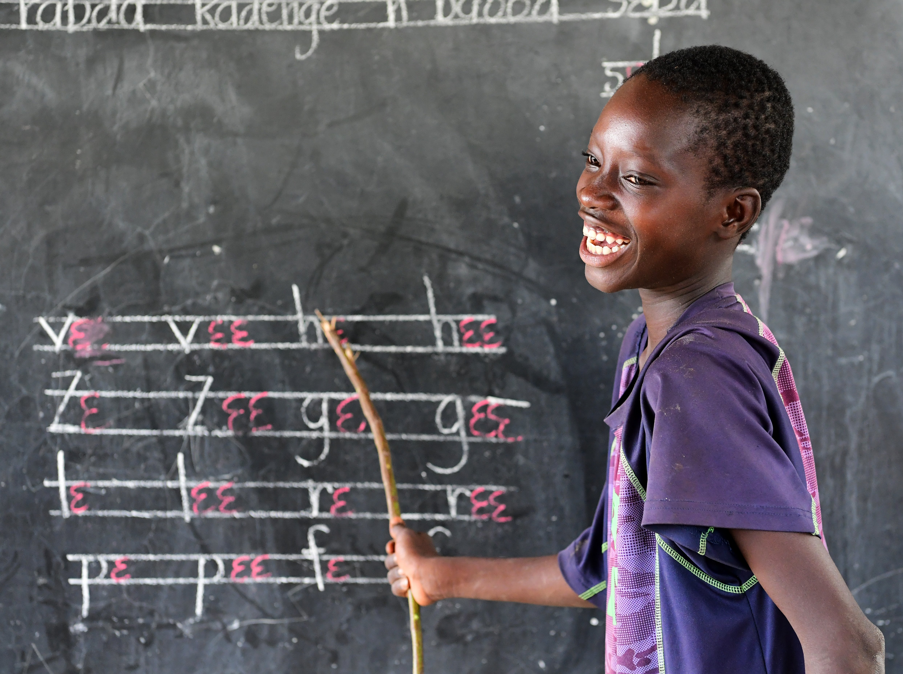



Global Education Monitoring Report
Education finance
26 June 2025
Education Finance
gemreport@unesco.org

Slide 2

Education has significant unmet needs
New estimates show that there are 272 million children and youth out of school
The increase is due to:
◆ new data showing further slowdown
( 8 million)
◆ upward adjusted UN population projections ( 13 million)
200
Out of school rate, by age group
180
160
140
Upper
Million
120
secondary
Further assessment of out-of-school number in 10 countries affected by conflict recognizes undercount:
◆ At least  13 million more are out of school, mostly in Myanmar, Sudan and Somalia
100
80
Primary
60
Lower
secondary
40
20
0
2000
2005
2010
2015
2020
2023

Slide 3


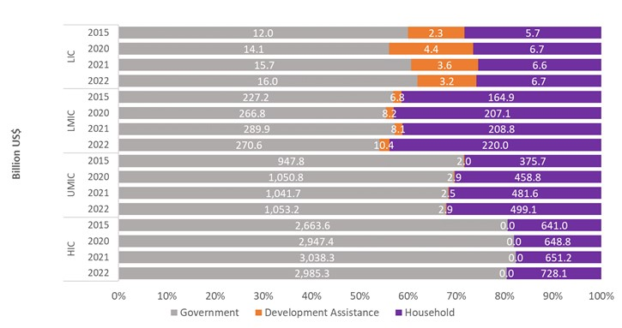
Aid is still vital for the poorest countries
Education Finance Watch 2024
Distribution of total education spending by source
by income group, percentage [billion US$]
Aid accounts for 12% of total and 17% of public education spending in low-income…
Households account for 40% of total spending in lower middle-income and…
Governments account for 80% of total spending in high-income countries
Notes:
The last Education Finance Watch – released in October 2024 joint with the World Bank and the UIS
Here the graph shows the allocation of total education spending divided by income group across years and how that is shared between governments (grey), external funders (orange), and households (purple).
Governments are the main funders of education as you can see – primarily in high income countries, where they cover over 80% of total spending.
You also see the high contribution of households in low and lower middle income countries – making up over 40% in lower middle income countries.
And you see that external financing is critical in the poorest countries, making up 12% of total spending on education and 17% if you exclude households.

Slide 4
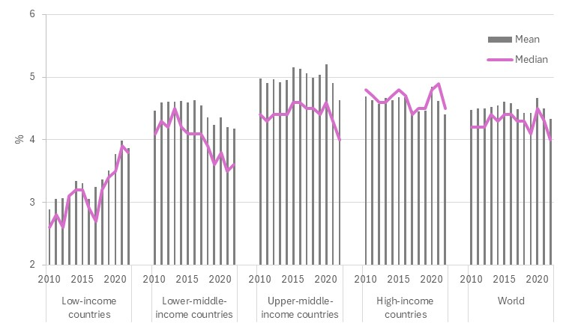
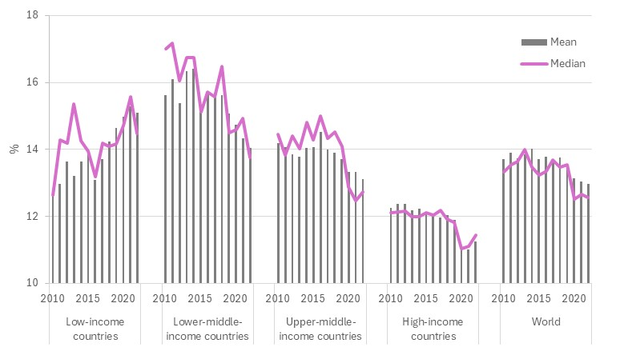
Public spending is not keeping up
34% of countries meet neither education financing benchmark (4% and 15%)
Government education spending
as a share of GDP
A fall by 0.3-0.4 percentage points
on average globally since 2015
Government education spending
as a share of total public expenditure
A fall by 0.6-0.7 percentage points
on average since 2015
Up to 2 points in middle-income countries
Notes:
The context is shown by this graph
The graph on the left shows countries’ progress towards the benchmark target of allocating at least 4% of GDP to education
On the right it shows progress towards the progress of allocating at least 15% of total public expenditure
We have divided it by income group.
The mean and the median vary by the number of countries, but trends align no matter what average you take.
On the left – globally since 2015, there has been a small decline of 0.3-0.4 pp (a decline of almost 10%), but a more sizeable decline as a share of public expenditure on the right, particularly in middle income countries, where the share of education in their budgets had declined by almost 2pp or more.
This shows there is is a deprioritisation of education – mostly because of public debt pressures on many of these countries. We are not yet at the situation that countries faced in the 1980s/90s, but, if trends continue, we could be there in 2030s. And we should remember that poor countries lost 2 decades of educatoin development as a result of that situation.

Slide 5
The share of interest payments relative to education is high
Interest payments account for:
43% of education spending per capita in low-income countries
48% of education spending per capita in lower-middle-income countries
Low-income countries Lower-middle-income countries

Slide 6
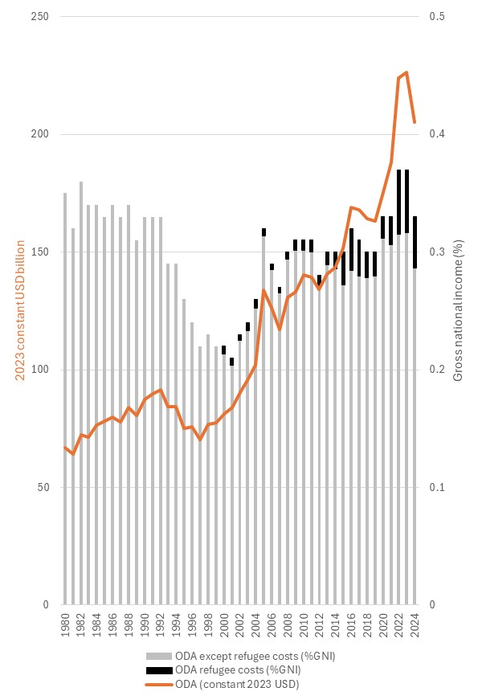
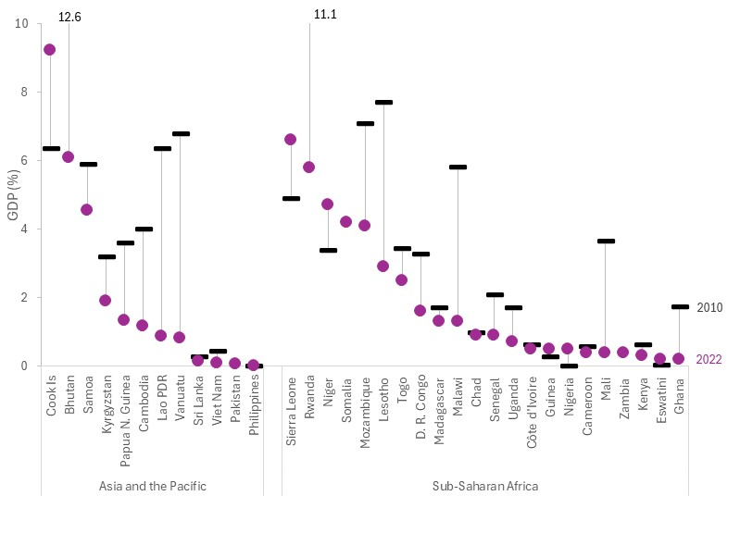
Total aid spending is stuttering and grants falling out of fashion
Falling in significance as poor countries develop faster
Aid
as share of OECD DAC GNI
Grant revenues
as share of GDP, 2000–22
Notes:
On the left, you see the emphasis that OECD DAC member states are putting on aid.
The line is the total amount of aid spending, which shows a large increase in 2022 and 2023 linked to Ukraine.
But as a share of their GNI – the bars – countries have been spending about the same amount of money as they did in the 1980s.
There was a dip in the 1990s, possibly at the end of the Cold War and the debt crisis.
But it grew again in the 2000s back to original levels.
The black share is the amount going to refugees in donor countries – if you exclude that you can see that levels today are in fact lower than they were in the 1980s.
This graph on the right-hand side shows the share of revenues of governments in select groups of countries that are grants that go to budgets – the idealistic picture we have of aid. But you can see that it’s a very small % of aid, but is also rapidly declining.
In Africa, the share of grants in GDP, which is primarily aid, has more than halved since 2010. That is a consequence of the countries growing faster than their donors, but also the decline overall in the types of aid that goes to directly benefit them.

Slide 7
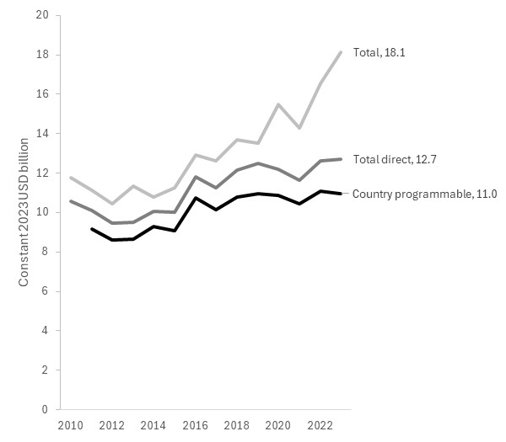
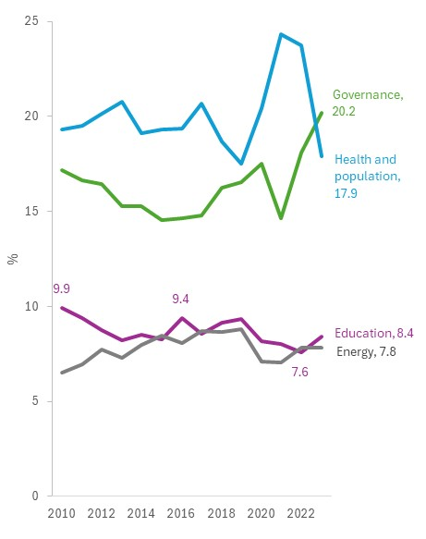
Education aid has stagnated since 2016
Aid, three definitions
Constant 2022 USD billion, 2010–23
Education
as share of allocable aid, 2010–23
Notes:
The figure we have been reporting since 2002 covering budget support and aid to education grew steadily since 2010, and more substantially as a reflection of the crisis in Ukraine, but
But if you look at the amount going direct to countries – and excluding scholarships – aid has not changed since 2016, and is perhaps lower when it comes to country programmable aid, which is the type of aid that countries can plan for and absorb into their education systems.
This is partly because there is a decline of the priority that donors are giving to education as you can see on the right hand side: education fell from 9.9% of allocable aid in 2010 to 7.6% in 2022, with a small uptick after that.
By contrast, you can see that energy has closed the gap that it had with education.

Slide 8
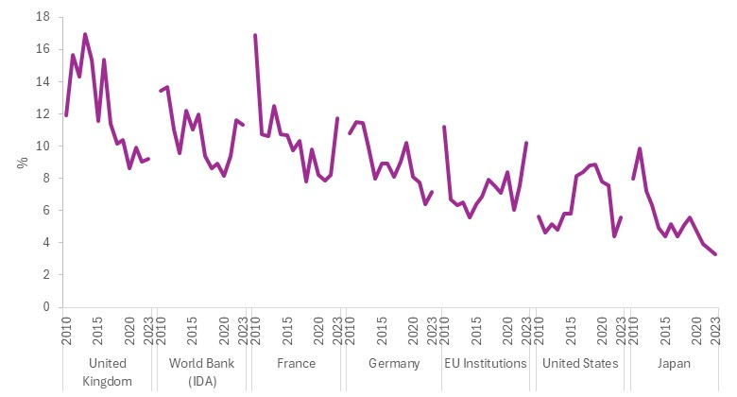
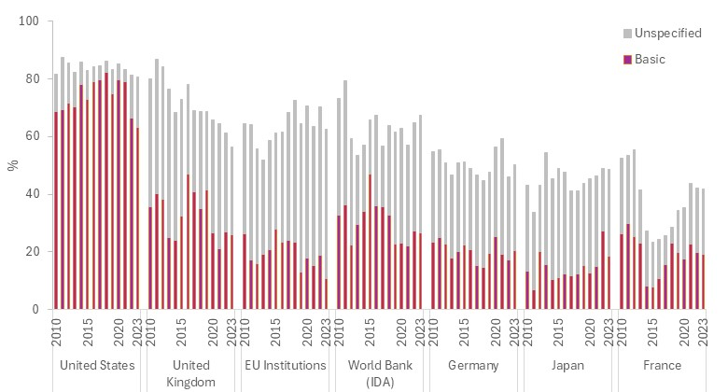
Education aid falling down donor priorities
Education
as share of allocable aid, 2010–23
Education is falling down most major donors’ priority lists
Basic education
as share of aid to education, 2010–23
The share of basic education fell from 40% in 2016 to 30% in 2023
Notes:
In both graphs you see the 7 largest donors and the shares they allocate to education.
You can see that within each donor, with the exception of the EU in recent years, they have deprioritized education.
Within this group, some have put more emphasis on education, like the UK, and others that have put less, like Japan.
On the bottom, you see the distribution of aid on two levels.
The purple part shows aid to basic education. And you can see that the US allocated a far greater share of its aid to basic education, while other donors allocate their aid to other levels.
What we have also included is what is called ‘unspecified’. Sometimes aid reported to the OECD is not clear where it’s going. We have included that here, as it may be going to education, but the point still stands that the trends are declining over time.

Slide 9

Education aid levels fell in 2024
Global aid to education projected to fall by one-quarter
First-ever analysis of IATI data shows that aid to education fell by 12% in 2024
If donor cuts announced in early 2025 take effect, aid to education will contract by a further 14% by 2027
Notes:
The GEM Report has looked at a new source of information on aid to education, the IATI database.
Previous reporting has focused on the OECD CRS database. Its primary disadvantage is that data appears with a two-year lag.
The IATI initiative is a reporting standard adopted in 2008 as part of the implementation of the Accra agenda. It is voluntary, but used by many more actors than the OECD platform. It is being updated on a live basis.
Our analysis of this data source was to look at 17 donors where we thought that reporting was comparable to the information in the OECD database and to see what we could see on trends.
You can see from the line above the bar chart that the trends are consistent across both sources.
The IATI data shows that the decline in aid will be notable in 2024

Slide 10
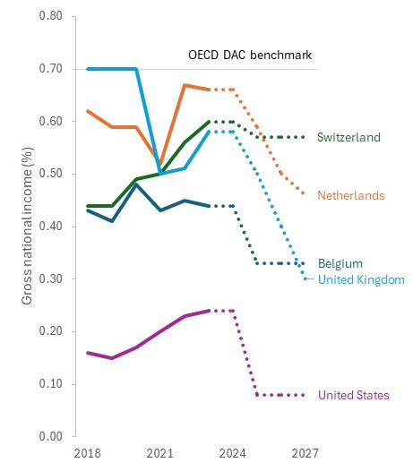
Education aid projected to fall further in coming years
Changes in aid policies
Share of GNI, 2018–27
These cuts are the combined effect of reductions in Belgium, France, Germany, Sweden, Switzerland, the United Kingdom, and the United States
Notes:
We have been analysing donors’ levels of spending on aid as a share of their gross national income.
Many traditional donors are likely to reduce the share of their budget that is going to aid. This is something the GEM Report is constantly updating as budget statements come in.

Slide 11
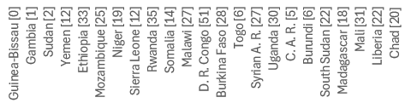
Falls in aid will affect some countries particularly hard
Projected loss of aid to education
Change from 2023 values (%)
100
80
Loss
The projected cuts could halve the amount of aid to education being received by countries such as Liberia and Chad
%
60
40
20
Aid to
education
0
Notes:
We have projected what this would mean in terms of income on aid to education for low-income countries.
This graph shows that some countries are projected to lose around half of their aid to education: Liberia and Chad are mentioned here

Slide 12

Project-based funding is increasing
The share of bilateral aid channelled through projects has risen from 55% to 64% from 2010 to 2022.
…resulting in aid fragmentation
Notes:
One of the consequences of project-based interventions is the fragmentation of aid. In 2019, low- and lower-middle-income countries had an average of 25 donors to education (UNESCO, 2021). Under such circumstances, education ministries face a heavy burden aligning project timelines and managing multiple reporting requirements. They plan reactively, allocate resources inefficiently, and struggle to develop their systems

Slide 13

Education faces multiple financing disadvantages
1. Education lesser priority than health or energy
2. Education not suited to results-based aid
3. Education more likely to rely on grants
Notes:
Educatoin is facing multiple disadvantages.
The outlook for aid to education is negative.
But, not only is there a shift away from aid and development, but there is also a lessor priority given to education within that.
3. If we interpret results as outcomes, education is also not well situated. There is very little that can be achieve in terms of learning in a short time period. We always argue that it is important to invest in education institutions, but this is unlikely to give results in the time of time frame that donors want.
4. Finally here you can see that educatoin is more exposed to grants than other sectors – 60% of aid to education is in the form of grants.

Slide 14

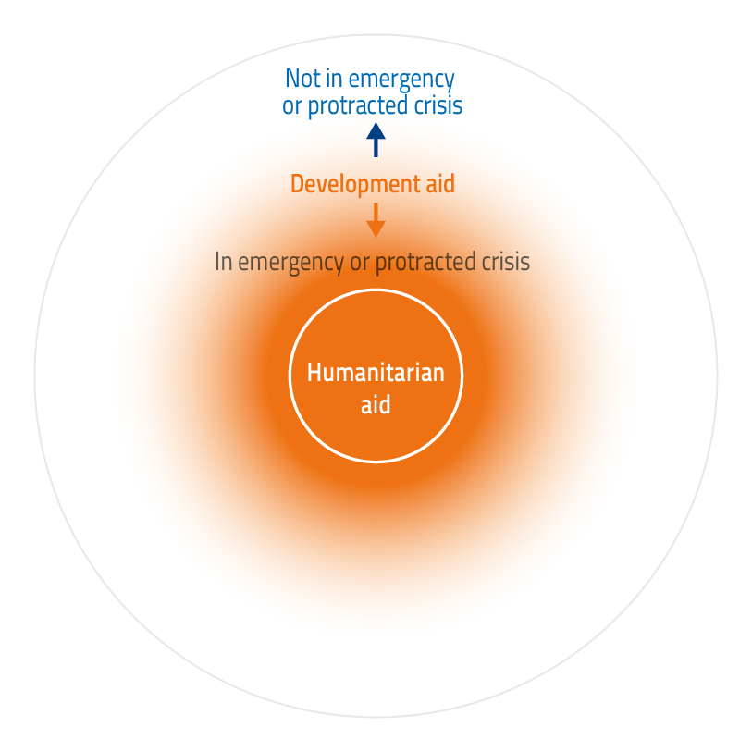
It is hard to define education financing in crises
Education financing in crisis contexts has both humanitarian and development objectives
Yet reporting systems continue to categorize interventions as either humanitarian or development in somewhat arbitrary ways
This limits the ability to monitor consistently education financing in crisis contexts
Notes:
Some donors are shifting more of their support to emergencies.
That generates discussions about what it humanitarian and what is development aid.
Often the line between them is blurred.
In reality, if you take a conflict affected country, there is an element of funding that goes to humanitarian projects – primarily through OCHA – and then there is also funds that come from development aid budgets to support emergency contexts.
A paper produced with Education Cannot Wait looks at three databases – the IATI, the OCHA and the OECD CRS – to see what we could find on this issue.
It shows that the funds reported on the platforms do not overlap, so it important to use them additively.
We can see that aid for EiEPC has been increasing, but the share of that that is considered strictly humanitarian is declining – with more coming from development aid. In 2024, for instance, even though the overall trends of aid to education may have been declining, the amount that went to emergencies and protracted crises has been increasing.

Slide 15
It is hard to track funding for education in crises too
Education in emergencies and protracted crises in increasingly funded through development aid
100
Humanitarian
80
The share of funding for education in crises through development aid increased
from 70% in 2017
to 92% in 2023
60
%
40
20
Development
0
2016
2017
2018
2019
2020
2021
2022
2023

Slide 16
Looking across databases improves aid transparency
Humanitarian aid to education represents a small proportion of funding even in crisis-affected countries

Slide 17
Education in emergencies financing is increasing
IATI data show that financing of education in emergencies has been rising as crises become more protracted
1,500
1,250
EiE, humanitarian
Constant 2022 USD million
Three databases, CRS, FTS and IATI, agree that financing of education in emergencies has been rising
IATI, despite limitations, can be used to monitor trends
1,000
750
EiE, development
500
250
0
2019
2020
2021
2022
2023
2024

Slide 18
Recommendations
Aid to education
As aid to education is projected to decline, it is necessary to shift more resources:
◆ Through multilateral channels, while ensuring less earmarking of aid
◆ Through national budgets, in order to reverse the trend towards project-based aid
◆ Toward system strengthening, in order to build institutions instead of achieving short-term results
◆ Toward lowering the cost of borrowing, while building a new development-oriented debt architecture
◆ Toward global public goods in education, which are most at risk in a time of aid cuts

Slide 19
Recommendations
Education in crises
A coordinated approach is needed to improve reporting on funding education in emergencies and protracted crises.
◆ Align the three main reporting systems – the CRS, FTS and IATI – to reflect the full scope of funding education in crises
◆ Improve reporting standards and classification processes in the three databases to improve the quality and comparability of data between them
◆ Enhance collaboration among the three databases and reporting agencies to harmonize taxonomies, develop cross-referencing mechanisms and reduce duplication
◆ Make comparable education funding data accessible and actionable to build a shared, transparent and timely evidence basis and inform decisions across the humanitarian–development continuum

Slide 20

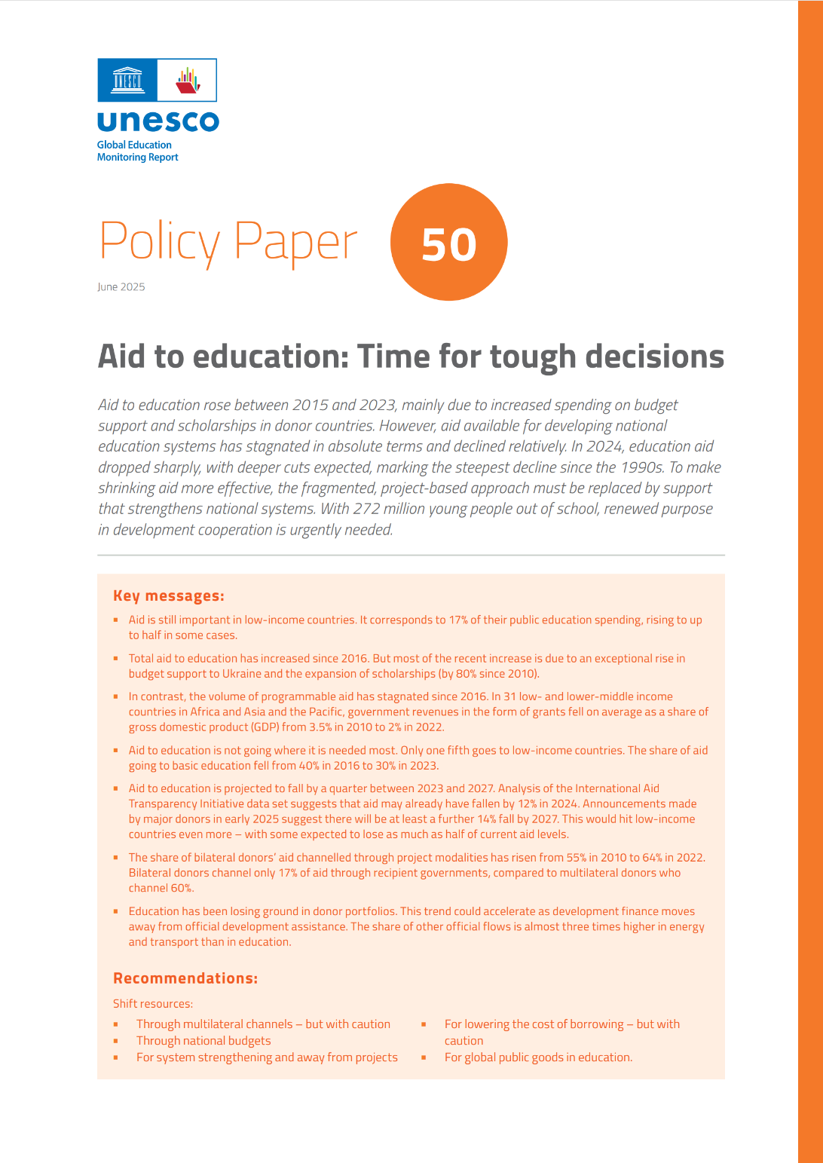
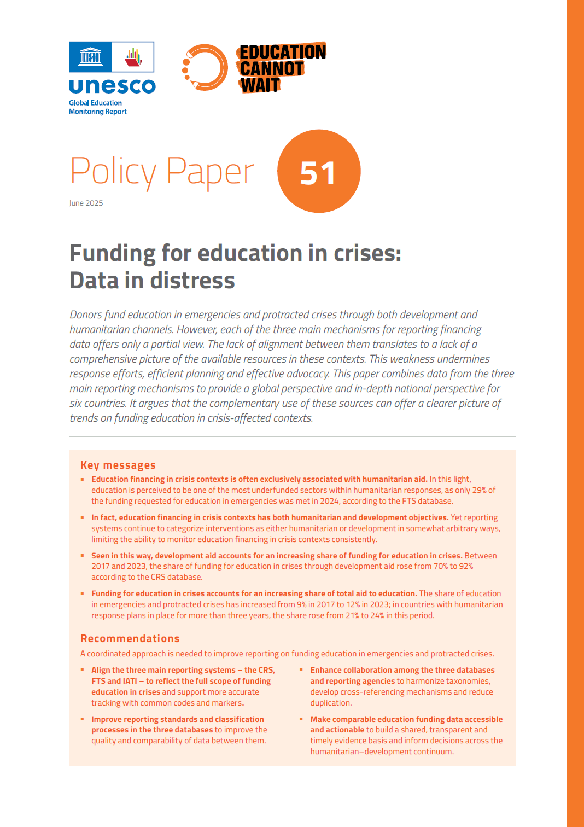
Thank you
Find this presentation, social media resources and all resources on education finance here:

